Slide 1

PowerShell Scripting Basics
Adam Driscoll
Adam Driscoll
Twitter: @adamdriscoll
adriscoll@concurrency.com
Senior Application Developer

Slide 2
Agenda
Execution Policies
Creating Objects
Formatting
Streams
Error Handling
Functions
Scope
Drive System
Debugging
Lab

Slide 3
Execution Policies
Prevent running of unsigned scripts
Can be set by group policy
NOT a security feature

Slide 4
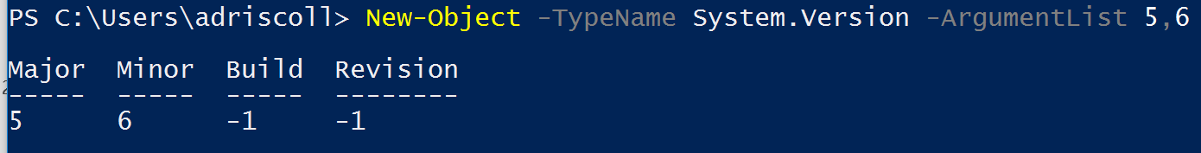
New-Object
Get-Help about_Object_Creation

Slide 5
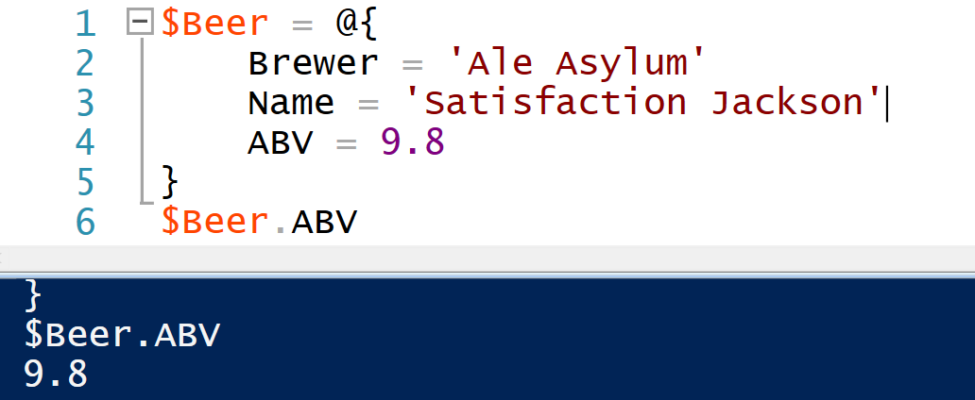
Hashtables
Notes:
Code .\Hashtables.ps1

Slide 6
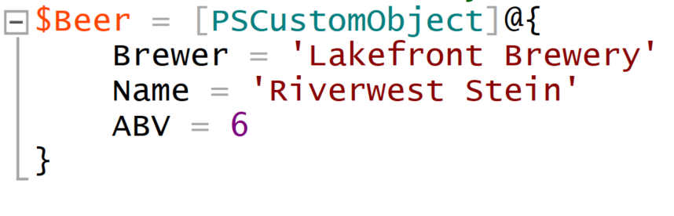
PSCustomObject

Slide 7
Hashtables, New-Object, PSCustomObject
New-Object – Long winded syntax but preserves property order and formating
Hashtables – Easy syntax but doesn’t preserve property order and formatting
PSCustomObject – Easy syntax and preserves property order and formatting
Notes:
.\ObjectCreation.ps1

Slide 8
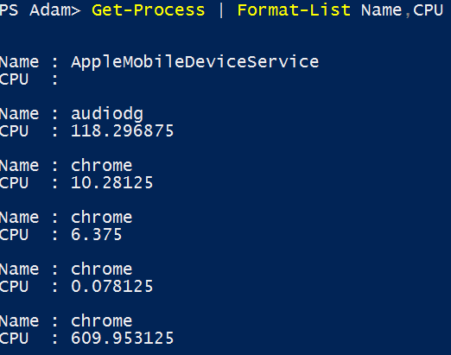
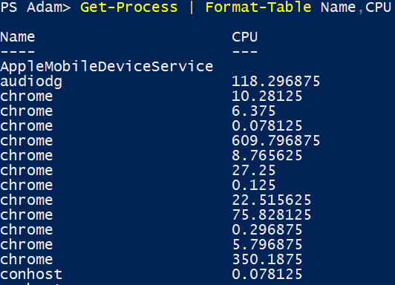
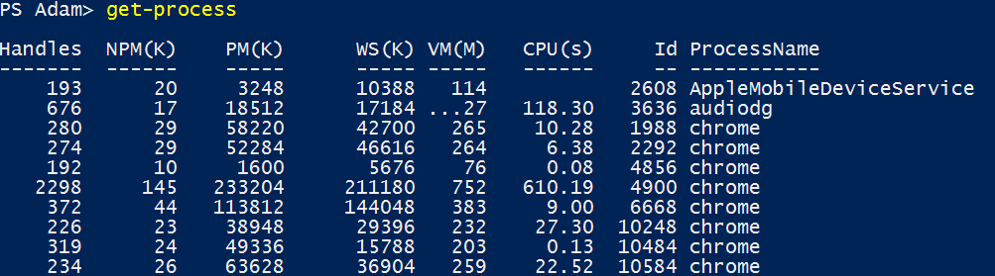
Formatting Data
Formatting Cmdlets
Default Formatting Files
Notes:
.\Start-Demo -File .\Formatting.txt

Slide 9
Streams
Verbose – Trace messages
Warning – Warnings but not errors
Debug – Trace messages that cause the cmdlet to halt in the debugger
Error – Non-terminating errors
Information - Only available in PowerShell v5. Used for Write-Host output.
Notes:
ISE .\Streams.ps1

Slide 10
Error Handling
Non-Terminating – Does not cause script to halt
Write-Error – Produce non-terminating errors
Terminating – Causes script to halt
Throw – Produces terminating errors
Try catch – Deal with terminating errors
ErrorAction – Change how commands behave when errors occur
Notes:
Code .\ErrorHandling.ps1

Slide 11
Functions
Encapsulates logic so that it is reusable, easy to understand,
Accepts parameters
Executed just like cmdlets
Notes:
Code .\Functions.ps1

Slide 12
Scope
The following are the basic rules of scope:
An item you include in a scope is visible in the scope in which it was created and in any child scope, unless you explicitly make it private. You can place variables, aliases, functions, or Windows PowerShell drives in one or more scopes.
An item that you created within a scope can be changed only in the scope in which it was created, unless you explicitly specify a different scope.
Get-Help about_Scope
Notes:
Code .\Scope.ps1

Slide 13
Drive Provider System
Use standard file system-style commands to traverse hierarchal data structures
Built In Examples
Registry
Alias
Certificate
Environment Variable
-Third-Party Examples
System Center Operations Manager
Microsoft SQL
Notes:
.\Start-Demo -File .\Drives.txt

Slide 14
Debugging
Breakpoints
Call stack
Evaluating variables
Notes:
DEMO HERE

Slide 15
Lab
1. Set a new environment variable using the environment variable drive provider and output the variable via Write-Host.
2. Create a function that returns a hashtable with the current time, your computer name and number of processes running on your machine.
3. Create a function to find all txt files in the directory specified by the user of your function.
Make sure you add error handling into your function.
Make sure to include Verbose and Warning messages.
Output file names and size in a table

